Slide 1
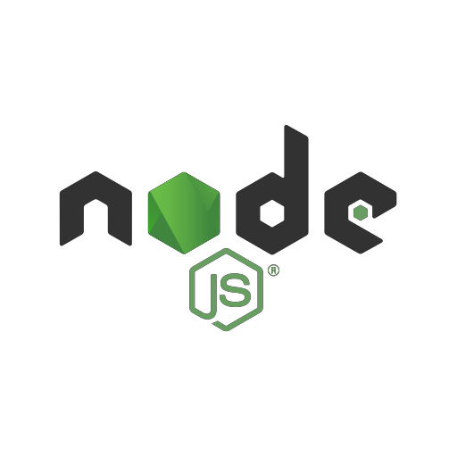
The Server-side
JavaScript
Day 2

Slide 2
NODEJS GLOBALS
filename - represents the filename of the code being executed. This is the resolved absolute path of this code file.
dirname - represents the name of the directory that the
currently executing script resides in.
setTimeout(cb, ms) - used to run callback cb after at least ms milliseconds.
clearTimeout(t) - used to stop a timer that was previously created
with setTimeout().
setInterval(cb, ms) - used to run callback cb repeatedly after at least ms milliseconds.
Global Objects:
process – object providing information and methods for the current process
Its a global object and can be accessed from anywhere.
It is an instance of EventEmitter.
console – allows printing to stdout

Slide 3
CUSTOM MODULE
As we knew before; Modules is where we can encapsulate related functionality into a single file.
Creating a module is easy, just put your JavaScript code in a separate .js file and include it in your code by using keyword require, like:
var myModule = require(“./myModule.js”);
To require local created module, we have to pass relative path to its .js file; so nodejs knows that its not going to looking for it in node_module folder.

Slide 4
CUSTOM MODULE – EXPORTS (CONT.)
As long as our module doesn't expose anything, the above isn't very useful. To expose things we use module.exports and export everything we want:
 If we consider a new module names ‘misc.js’:
var x = 5;
var addX = function(value) { return value + x; }; module.exports.x = x;
module.exports.addX = addX;
 Now we can use our loaded module:
var misc = require('./misc');
console.log("Adding %d to 10 gives us %d", misc.x, misc.addX(10));

Slide 5
CUSTOM MODULE – EXPORTS (CONT.)
There's another way to expose things in a module (specially when exposing custom objects and function constructor
var User = function(name, email) { this.name = name;
this.email = email;
};
module.exports = User;
 The difference between:
module.exports.User = User;
//vs
module.exports = User;
 is all about how it's used:
var user = require('./user');
var u = new user.User();
//vs
var u = new user();

Slide 6
CUSTOM MODULE - REQUIRE
require() looks for module based upon passed parameter
“../module_nm” – looks in parent directory
“./module_nm” – looks in same directory
“/module_nm” – looks in the given path (absolute)
“module_nm” – searches inside node-module of application directory then search globally.
Inside node-module there is a directory for each module

Slide 7
EVENTS MODULE
Event Driven Programming:
Node.js uses events heavily and it is also one of the reasons why Node.js is pretty fast compared to other similar technologies.
As soon as Node starts its server, it simply initiates its variables,
declares functions and then simply waits for event to occur.
Event loops: In an event-driven application, there is generally a main loop that listens for events, and then triggers a callback function when one of those events is detected.
Node.js has multiple in-built events available through events module and EventEmitter class which is used to bind events and event listeners as follows:
// Import events module
var events = require('events');
// Create an eventEmitter object
var eventEmitter = new events.EventEmitter();
Following is the syntax to bind event handler with an event:
// Bind event and even handler as follows
eventEmitter.on('eventName', eventHandler);
We can fire an event programmatically as follows:
// Fire an event eventEmitter.emit('eventName');

Slide 8
EVENTS MODULE (CONT.)
Many objects in Node emit events for example a net.Server emits an event each time a peer connects to it, a fs.readStream emits an event when the file is opened.
All objects which emit events are instances of
events.EventEmitter.
When an EventEmitter instance faces any error, it emits an 'error' event. When new listener is added, 'newListener' event is fired and when a listener is removed, 'removeListener' event is fired.
EventEmitter provides multiple properties like on and emit. on property is used to bind a function with the event and emit is used to fire an event.
EventEmitter Methods and properties:
 http://www.tutorialspoint.com/nodejs/nodejs_event_emitter.htm

Slide 9
EXPRESS
Express is a web application framework for building web apps with node as our backend system.
Express is a minimal and flexible Node.js web application framework that provides a robust set of features to develop web and mobile applications.
It facilitates a rapid development of Node based Web applications.
Following are some of the core features of Express framework:
Allows to set up middlewares to respond to HTTP Requests.
Defines a routing table which is used to perform different
action based on HTTP Method and URL.
Allows to dynamically render HTML Pages based on passing arguments to templates.

Slide 10
EXPRESS - INSTALLATION
Installing Express:
install the Express framework using npm
npm install express --save
Above command saves installation locally in node_modules directory and creates a directory express inside node_modules.
There are following important modules which you should install along with express:
body-parser - This is a node.js middleware for handling JSON,
Raw, Text and URL encoded form data.
cookie-parser - Parse Cookie header and populate req.cookies with an object keyed by the cookie names.
multer - This is a node.js middleware for handling
multipart/form-data.

Slide 11
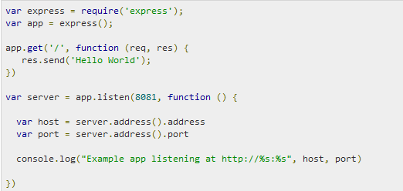
EXPRESS - EXAMPLE
Following is a very basic Express app which starts a server and listens on port 8081for connection.
This app responds with Hello World! for requests to the homepage. For every other path, it will respond with a 404 Not Found.
Save the code in file “server.js” for example.
Then run it: node server.js
Open http://127.0.0.1:8081/ in any browser, you should see “Hello world” printed in the browser.

Slide 12
EXPRESS - REQUEST & RESPONSE
Express application makes use of a callback function whose parameters are request and response objects.
app.get('/', function (req, res) { // -- })
Request Object - The request object represents the HTTP request and has properties for the request query string, parameters, body, HTTP headers, and so on.
Response Object - The response object represents the HTTP response that an Express app sends when it gets an HTTP request.

Slide 13
EXPRESS (CONT.)
Basic Routing:
Routing refers to determining how an application responds to a client request to a particular endpoint, which is a URI (or path) and a specific HTTP request method (GET, POST, and so on).
Serving Static Files
Express provides a built-in middleware express.static to serve static files, such as images, CSS, JavaScript etc.
You simply needs to pass the name of the directory where you keep your static assets, to the express.static middleware to start serving the files directly.
For example, if you keep your images, CSS, and JavaScript files in a directory named public, you can do this: app.use(express.static('public'));
Post & get Methods

Slide 14
EXPRESS (CONT.)
Basic Routing:
Routing refers to determining how an application responds to a client request to a particular endpoint, which is a URI (or path) and a specific HTTP request method (GET, POST, and so on).
Demo !
Serving Static Files
Express provides a built-in middleware express.static to serve static files, such as images, CSS, JavaScript etc.
You simply needs to pass the name of the directory where you keep your static assets, to the express.static middleware to start serving the files directly.
For example, if you keep your images, CSS, and JavaScript files in a directory named public, you can do this: app.use(express.static('public'));
Demo !
Post & get Methods
Demo !

Slide 15
EXPRESS – COMPLETE DEMO: CREATING JSON BASED
REST stands for REpresentational State Transfer. REST is web standards based architecture and uses HTTP Protocol.
It revolves around resource where every component is a resource and a
resource is accessed by a common interface using HTTP standard methods.
A REST Server simply provides access to resources and REST client accesses and modifies the resources using HTTP protocol. Here each resource is identified by URIs/ global IDs. REST uses various representation to represent a resource like text, JSON, XML but JSON is the most popular one.
Web services based on REST Architecture are known as RESTful web services. These webservices uses HTTP methods to implement the concept of REST architecture. A RESTful web service usually defines a URI, Uniform Resource Identifier a service, which provides resource representation such as JSON and set of HTTP Methods.
HTTP methods: Following four HTTP methods are commonly used in REST based architecture.
GET - This is used to provide a read only access to a resource.
PUT - This is used to create a new resource.
DELETE - This is used to remove a resource.
POST - This is used to update a existing resource or create a new resource.

